Slide 1
Examinations Council of Zambia
Ensuring Efficiency and Security in the Transmission of Candidates’ Scores in Public Examinations
13th SAAEA Conference
held from
19th -22nd May 2019
in
Gaborone - Botswana
Presenter: Christine Simfukwe BSc (Greenwich), MSc(UTMalaysia)

Slide 2
Outline
Introduction
Problem Statement
Research Objectives
Methodology
Findings
Conclusion
Recommendations

Slide 3
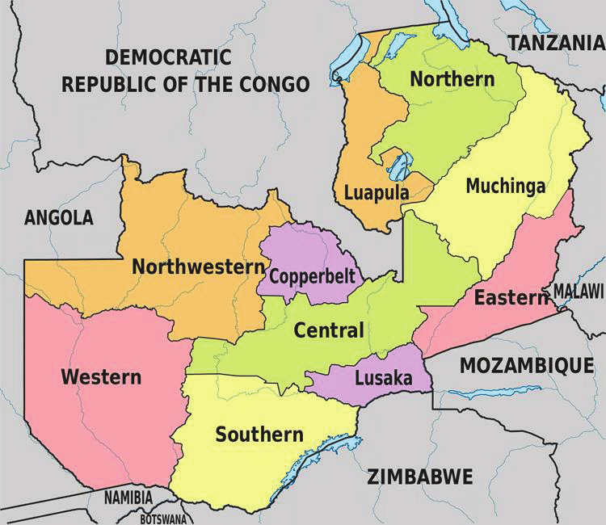
Introduction
Prior to 2016, the transfer of marks was manual
Marks Transported by road to ECZ Hq
Delays, Costly & Risky
Notes:
Marks transported by road to the ECZ Hq - 3 to 7 days.
Delays in processing , high cost & risky.

Slide 4
Problem Statement
Manual transfer of scores on external storage media:
Inefficiencies
Increased Costs
Security Risks
This study investigated the use of SFTP in the transfer of marks to increase efficiency, security and cost reduction.
Notes:
By road to Hq Led to the following challenges

Slide 5
Research Objectives
To evaluate the various online file transfer methods
To demonstrate the efficiency and security of SFTP
To identify the factors that ensure security in the transfer of marks online

Slide 6
Methodology
Descriptive research design –observations of a subject in the natural setting.
Population - 3000
Sample Target – 300 (10%) respondents
Data Collection Procedure – Questionnaire
Data Analysis Procedures – SPSS
Notes:
scientific method involving observations of a subject in the natural setting.
Limitation of Methodology Themes of the question which interogated using of likert scale etc
ECZ in 2017 piloted the transfer of marks using SFTP.
2018 rolled out to all 10 Provinces

Slide 7
Findings 1. Advantages & Disadvantages of Various Files Transfer Methods
No | File Transfer Method | Ease of Use | Cost | Encryption | File Size
1 | Email | Medium | Low | Low | Small
2 | FTP | High | Low | None | Medium
3 | SFTP | High | Low | Medium | Large
4 | File Sharing Service | Medium | Medium | High | Large

Slide 8
2. Efficiency of SFTP
Manual | SFTP
Manual System : 50% - 3 days, 35% 4-5 days and 15% more than 5 days | SFTP 83 % immediate 7% - 1-2 days
90% sited loss of data integrity | Minimal 10%
5 Points of data Exchange | Only 2

Slide 9
3.1 Security Points of Contact with Marks in the Manual Process

Slide 10
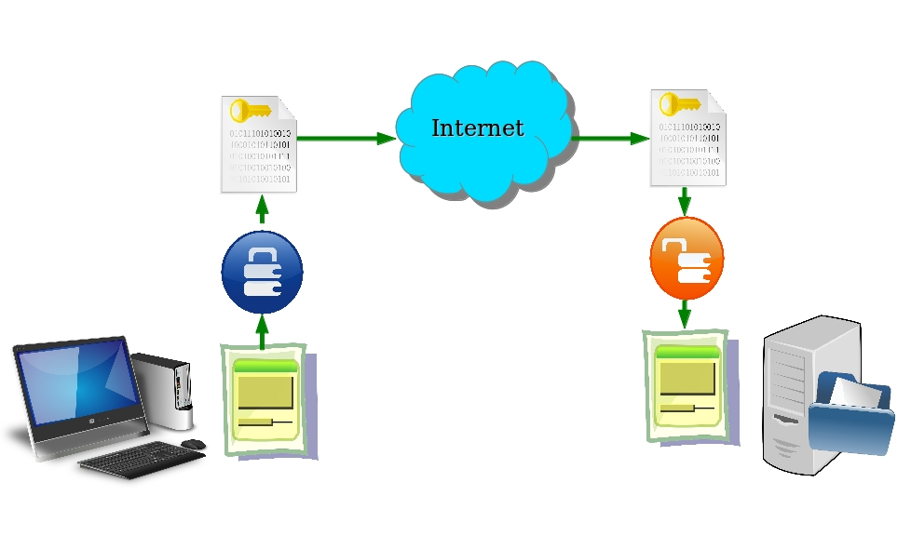
3.2 Security How SFTP Works (https://www.thesecuritybuddy.com/)

Slide 11
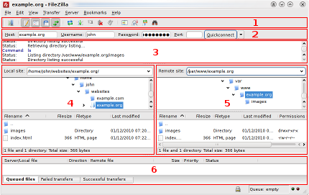
3.3 Security Main FileZilla Window

Slide 12
Conclusion
SFTP has reduced the costs involved in the transfer of marks.
Increased efficiency as marks are received on time which allows the processing of results to be done timely.
Improved security as data is transmitted over an encrypted connection.
Notes:
delays in processing , high cost & risky.

Slide 13
Recommendations
Even though the data is secure while in transit due to the encryption provided, SFTP is an old method therefore there is need to look at other methods to increase ;
Security and
Ensure visualisation in the marks entry and transfer of marks.

Slide 14
Thank you
Thank you

